Slide 1


Slide 2
WELCOME
VIC BHAGAT
EVP ENTERPRISE BUSINESS SOLUTIONS & CIO
EMC II

Slide 3



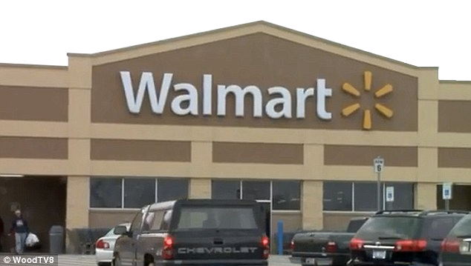
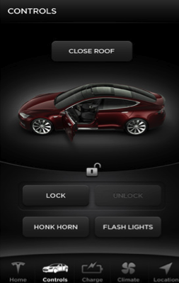
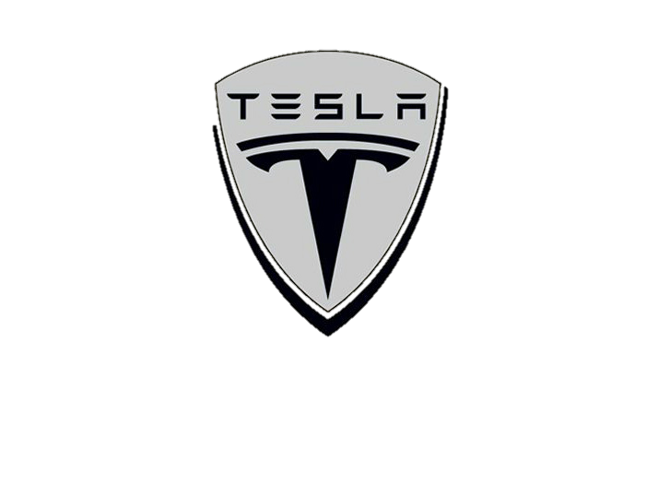
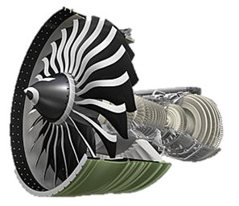
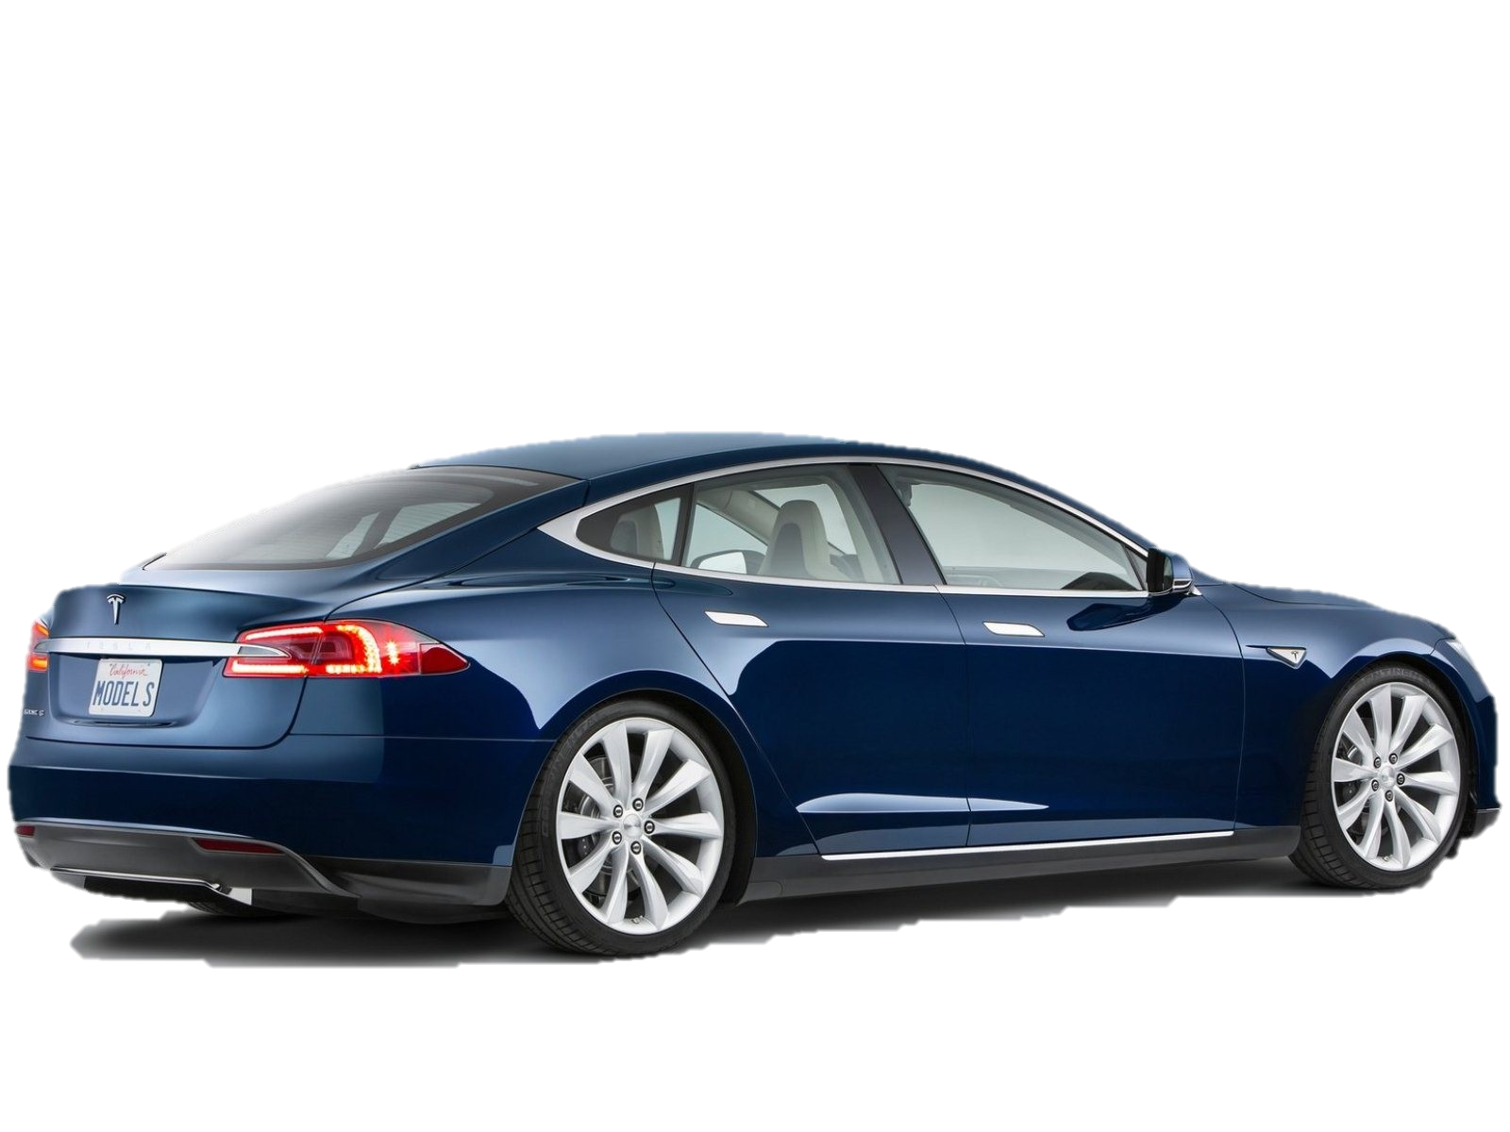
Industries ARE Facing Structural Change
Massive Change And Innovation
Applications Offer Infinite Possibilities
New Value Creation

Slide 4




CONVERGING MEGA TRENDS
The 3rd platform is underpinned by these key technology mega trends – Mobile, Cloud, Big Data and Social
…. But we shouldn’t be confused, these are purely enablers – on their own they mean very little to the business
Driving A New Digital Agenda
MOBILE
CLOUD
BIG DATA
SOCIAL
Source: IDC

Slide 5



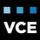

THE CIO’S DILEMMA
CFO’S VIEW
BUSINESS’ VIEW
An Expense To Cut
“Keep The Lights On”
Too Restrictive
To Be Avoided!!
Legacy Blues
100% Reactive
Are We Relevant?
© Copyright 2015 EMC Corporation. All rights reserved.
Notes:
The theme of this year’s Forum is “Lead your Transformation”. The world of IT is in the midst of unprecedented change, and the pressures that have resulted from that change have created an imperative for most IT organizations to realize that transformation is necessary.
On one side, you have the pressure associated with the way many CFOs view IT: as an expense line to be driven down; with a budgeting process that bases everything against a run rate; desiring IT to be run as a regulated monopoly with the CIO having responsibility of driving consumption of IT resources DOWN so as not to exceed the constrained supply.
On the other side, you have the pressures associated with an increasingly self-empowered Business, fueled by the consumerization trend. Increasingly, the Business sees IT as too slow, too expensive, to restrictive and consequently many Businesses are choosing to bypass IT for everything they can.
The CIO finds himself or herself in the middle of this pressure cooker, with an expansive, complex legacy that sucks up a majority of their budget just to keep it running, with demand for services that outstrips their budget, and their IT organization is on its heels reacting and responding in whack-a-mole fashion. And in the end, most CIOs are worried about the eroding relevance of their organization and the role of the IT function within their business.
These pressures are the genesis of IT transformation. And even though EMC is an IT Company, we are not immune to these pressures ourselves. In fact, we might have experienced some of these pressures earlier than most.

Slide 6









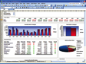


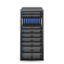

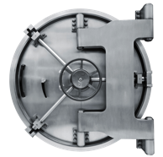


EMC IT AGENDA
Provide Access To All Applications & Data Through
Mobile Devices
Infrastructure & Applications
Designed For A Different Era
HELP THE
CFO
2
Use Agile Development To Build New Client-Centric
Applications
IT Systems Focused On Data Warehousing
Build A Data Lake To Deliver
Greater Insight In Real Time
IT Infrastructure Is Siloed &
Labor Intensive To Manage
IT Skills Focused On Reporting Of Historical Internal Data
Move To A Software-defined
Enterprise For Efficiency And Scale
IT Infrastructure Is Slow
To Provision
Use Adaptive, Data-Driven Security To Respond Rapidly To
Emerging Threats
Security Is Perimeter Based
& Focused On Intrusion Prevention

Slide 7







DELIVERING CONTEMPORARY IT
BUSINESS DEMAND
WORLD CLASS CLIENT EXPERIENCE
DIGITIZATION & AUTOMATION
ON-DEMAND SERVICES
Notes:
Redefining EMC IT starts with redefining our org structure. We have recently completed a re-org in EMC IT.
Over the past several years, we have delivered undeniable benefits to EMC’s business through the power of virtualization, cloud computing, big data and trusted IT. While we’ve already made tremendous strides in transforming our infrastructure, we have much more ground to cover in our quest to deliver IT as a Service and bring unprecedented agility and value to EMC.
While we will be driving many important changes in the infrastructure, applications, data and end-user computing domains, the most important and impactful changes will be to the IT Operating Model. The Operating Model sets us up for success by establishing a framework for organizing and operating IT more like a business. It consists of service centers, demand centers, and core service management and support functions which are linked to ensure our responsiveness, accountability and ability to deliver predictable, high-quality services.
Demand Centers
Building on BTG’s relationship with the business, leaders of our demand centers are strategically-aligned as trusted advisors to EMC’s business leaders and their teams are responsible for driving “day-to-day” delivery on behalf of the business unit, shaping demand by promoting the use of standardized services and service components, and proactively helping the BUs optimize the value they derive from their investments in IT capabilities. Demand Centers are the primary connection between the Service Centers and the business for all aspects of service level management including negotiation, reporting, identification and ultimate resolution of recurring SLA issues.
Service Centers
Our newly-created service centers will have end-to-end accountability for services delivered to our enterprise, BU and employee customers, and also for component services that are consumed by other service centers. The service centers will develop, deliver and automate value-driven, standardized services that address the majority of IT use cases, and customized services in those use cases for which a standardized service is insufficient, driving best practices into the Demand Centers.
Service Management and Support Functions
These functions enable IT to operate more like a business; supporting IT’s ability to conceive, develop, source, introduce, support, continuously improve and retire services as necessary to meet anticipated enterprise, BU and employee demand.

Slide 8




CUSTOMER CENTRIC IT
Each Segment Has Different Needs
CUSTOMERS
THE ENTERPRISE
LINES OF BUSINESS
EMPLOYEES
CREDIBLE IT PEERS
INTEGRITY & AVAILABILITY
AGILITY & CHOICE
PRODUCTIVITY & EXPERIENCE

Slide 9

PLATFORM MIGRATION APPROACH
PHASE 1: 2015 Net New & Mobile
All New Apps Developed In 3rd Platform(TES, AEM, …)
Mobile First – Developer Containers, Credentials
Security - Built In Not Bolted On
Analysis Of Legacy
PHASE 2: 2015-2016 Add Reusable Legacy
“Building Blocks” Realized Iteratively
Tools Available
Decomposed Legacy Moved To 3rd Platform For Most Utilized Set
Remote Conn
Global Support/ Desktop/Web
EMC.com
PHASE 3: 2016+ “Strangled” Legacy
Most Apps Now Exist In 3rd Platform
Diminishing Returns Of Moving Remaining Apps
Apps And Tools Continue To Grow In Value via Open Environment

Slide 10
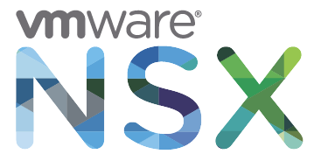
AN EXAMPLE – ePaaS
2H15
Enhancing Features And Community
Integrated Testing
Security Scanning
AIC: API Access To Data Services
Social / Community Integration
Pcf.next

Slide 11
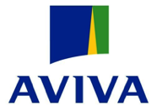

























WHO IS IN THE ROOM?

Slide 12
TODAY’S AGENDA
09:15 | Opening Keynote: IT In 2020 & The CIO Landscape | Vernon Turner, SVP Research, IDC
10:00 | EMC Federation Of Companies: Vision & Strategy | Jeremy Burton, President, Products & Marketing, EMC II Panel: David Goulden, CEO, EMC II Pat Gelsinger, CEO, VMware Bill Cook, President & COO, Pivotal
11:00 | NETWORKING BREAK
11.15 | Shifting Platforms & The Digitization Of Business | Jeremy Burton & Bill Cook
12:15 | NETWORKING LUNCH | Nobu Restaurant
13:30 | Adventures In Scale-Out Computing | Josh Bernstein, VP Technical Strategy, Emerging Technologies Division, EMC II (Formerly Of Apple)
14:00 | Business Transformation Driven By The Federation Hybrid Cloud | Tom Roloff, SVP Global Services, EMC II Panel: David Goulden & Pat Gelsinger
15:00 | NETWORKING BREAK
15:15 | Defending Our Brands In The Advanced Threat Era | Amit Yoran, President, RSA Bradley Maiorino, CISO, Target Brian Gammage, Chief Market Technologist, VMware
16:15 | Key Business Takeaways | Vic Bhagat
16:30 | The Formula 1 Experience | Jonathan Martin, CMO, EMC II
19:30 | Depart For Networking Dinner & Entertainment | Villa & Jardins de Rothschild, Saint-Jean-Cap-Ferrat

Slide 13

THANK YOU

